Slide 1
Accessibility and UDL
Online Teaching Symposium, 2021
Kimberly Shotick

Slide 2
Introduction
Kimberly Shotick
Assistant Professor,
Student Success Librarian University Libraries
She/they

Slide 3
Accessibility
Image credit: OSU Center for Teaching and Learning CC BY-NC 4.0
Notes:
This image is of layered ovals. The innermost oval is “accessibility”, follow by “universal design”, followed by “differentiated instruction”, and finally, encompassing all the ovals is “universal design for learning.”
What this suggests is that accessibility is at the core of all of these other ideas, but it is also the minimum. I’ll define accessibility as the accessibility on the web, given that we are talking about online teaching. Web accessibility means that websites, tools, and technologies are designed and developed so that people with disabilities can use them. More specifically, people can:
perceive, understand, navigate, and interact with the Web
contribute to the Web
Web accessibility encompasses all disabilities that affect access to the Web, including:
auditory
cognitive
neurological
physical
speech
visual

Slide 4
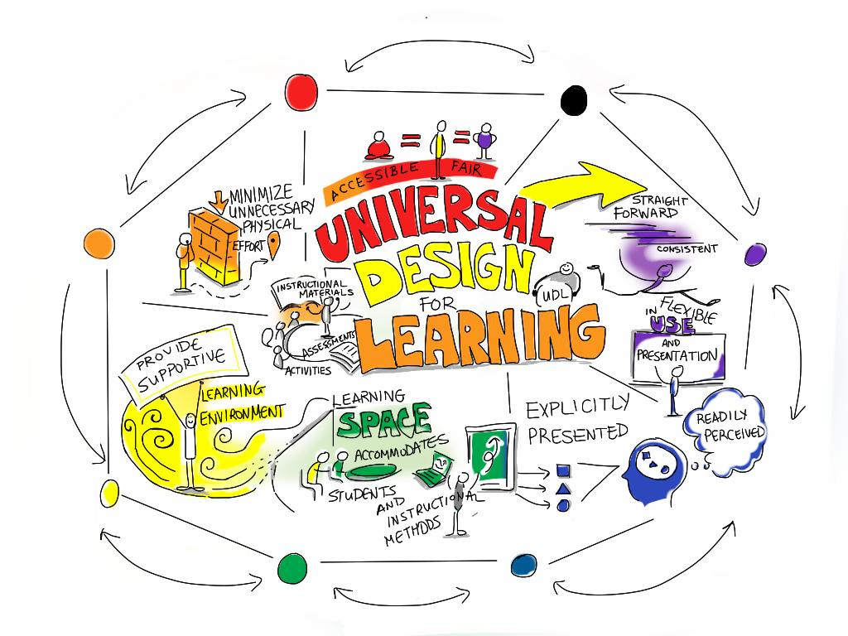
Universal Design for Learning
Image credit: Giulia Forsythe, CC BY-SA 3.0
Notes:
This image is a drawing of the words “Universal Design for Learning” with hand drawn images of a stick figure stopped by a brick wall, differently bodied stick figures, one leaping forward, one thinking, one teaching, and one holding up a sign. Universal Design for Learning, often called UDL, is “a framework to improve and optimize teaching and learning for all people based on scientific insights into how humans learn.” (CAST)

Slide 5
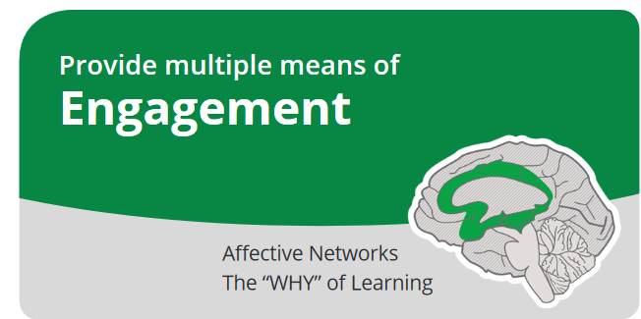
Universal Design for Learning
Adapted from: CAST (2018). Universal design for learning guidelines version 2.2 [graphic organizer]. Wakefield, MA: Author.
Notes:
The framework was developed by CAST, a nonprofit education research and development organization, and is centered around three guidelines. One, Provide multiple means of engagement. Beneath this are three checkpoints related to the guideline: Provide options for Recruiting Interest, Sustaining Effort & Persistence, and Self Regulation.
In practice, means that online learning includes relevant examples, provides contextual feedback to answers, and opportunities for learners to reflect on how well they learned new concepts and/or skills.

Slide 6
Universal Design for Learning
Adapted from: CAST (2018). Universal design for learning guidelines version 2.2 [graphic organizer]. Wakefield, MA: Author.
Notes:
The second guideline is to provide multiple means of representation. The associated checkpoints are: Provide options for Perception, Language & Symbols, and Comprehension.
In practice, this means that online learning includes multiple ways of accessing the information (e.g. visuals, text, audio), uses more than one example to illustrate a new concept or skill, and includes checks for understanding with feedback.

Slide 7
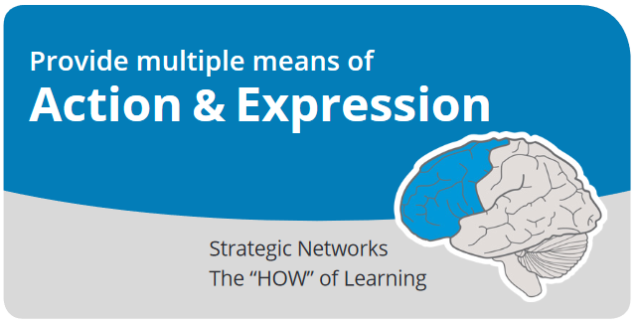
Universal Design for Learning
Adapted from: CAST (2018). Universal design for learning guidelines version 2.2 [graphic organizer]. Wakefield, MA: Author.
Notes:
The third and final guideline is the provide multiple means of action and expression. The related checkpoints are to Provide options for Physical Action, Expression & Communication, and Executive Functions.
In practice, this means that online learning adheres to accessibility principles, uses a variety of tools in order to help learners understand the content, and supports learners to find more resources to help them learn the content if necessary.
I’ll now demonstrate what it looks like to design learning modules with these guidelines in mind using the Library Orientation as an example.

Slide 8
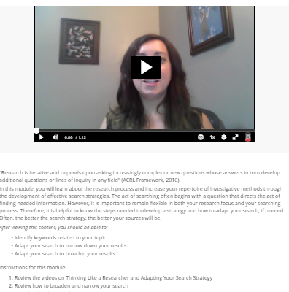
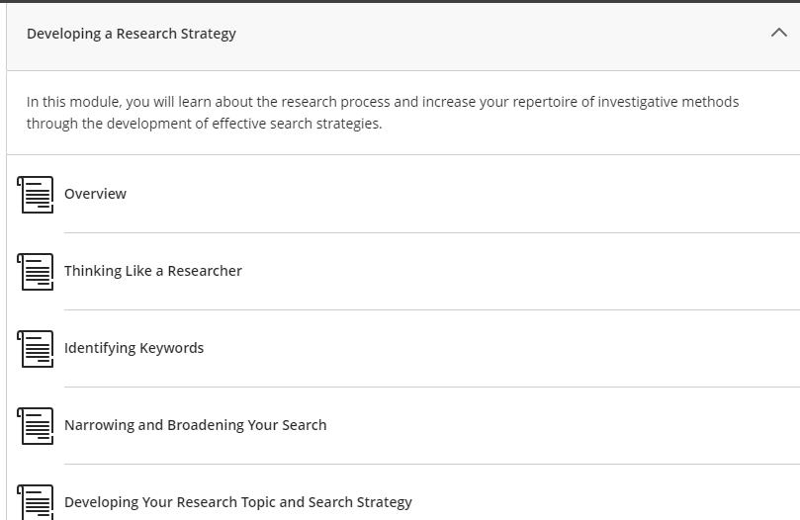
Library Orientation
Notes:
The Library Orientation is a set of learning modules that are designed to scaffold information literacy concepts across the undergraduate curriculum, beginning with UNIV 101 and is embedded in first year composition sections. Subject specialist librarians also use the orientation in discipline specific courses, modifying the content as necessary.
I won’t go into the content here, that’s another presentation. But what I want you to see if how I’ve used these principals throughout the modules as an example of putting them into practice.

Slide 9
Engagement & Representation
Optimize relevance, value, and authenticity
Optimize individual choice and autonomy
Notes:
The first guideline, engagement, has several checkpoints. CHECKPOINT 7.2, is to Optimize relevance, value, and authenticity
Individuals are engaged by information and activities that are relevant and valuable to their interests and goals. By contextualizing the learning objects in the deliverables for the course and overall course goals, you are activating their attention and interest. Begin by answering the question: “Why should I care?”
The second guideline is Representation, and CHECKPOINT 1.1 is Optimize individual choice and autonomy.
One of the tools we have available is Kaltura. You can upload or record a video into Kaltura, which then hosts the video. One thing that I like about it is the student’s ability to select the transcript, search it, display captions and change the way they look—even changing the language. They can change the speed, perhaps they need you to slow down. They can speed it up. The platform itself

Slide 10
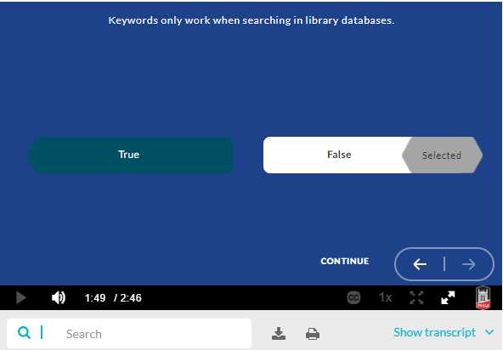
Action & Expression
Enhance capacity for monitoring progress
Notes:
The third guideline, Action and Expression, contains CHECKPOINT 6.4: to Enhance capacity for monitoring progress
In other words: do you have frequent check-points for students to monitor their own progress? This one can be tricky online—in the classroom formative assessments can tell you and the students how they are doing, but I’ve found this tricker to incorporate into online teaching. Again, I will talk up the tool Kaltura to provide a self-assessment, but also to maintain interest and engagement. You can upload a video to Kaltura Quiz and add quiz questions. The videos I’ve embedded directly into the modules are layered with quizzes that reinforce important content and allow for engagement and self-monitoring. These quizzes are not part of their grade, they are formative for the students.

Slide 11
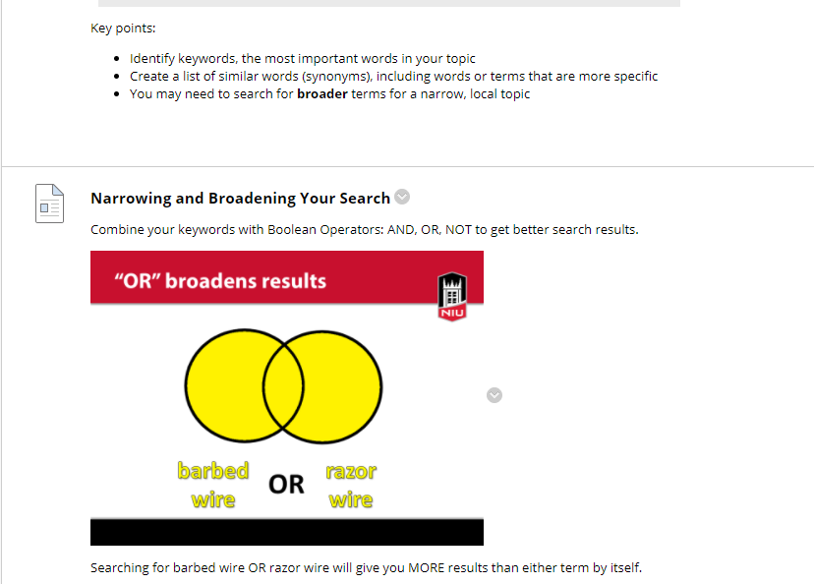
Action & Expression
Use multiple media for communication
Notes:
Another check point related to Action and Expression is CHECKPOINT 5.1 Use multiple media for communication
The information in the video is repeated as textual key points and in graphic organizers. Students who simply can’t sit through another video, have slow internet service, learn best by reading text, many learners in many circumstances will be able to access the same information.
Related to this, guiding the information processing through visualization and highlighting big ideas.
If and when possible, this means providing options for your students in how to demonstrate their master of the skills taught. A discussion board post, audio file, developing their own graphic organizer—they will select a method that interests them and makes sense to them. And by doing so they will learn the material that much better.

Slide 12
Questions
kshotick@niu.edu
@kshotick
Want the library orientation in your course?
http://go.niu.edu/lib
Kimberly Shotick
Assistant Professor, University Libraries

